Slide 1

CSCI 599: Content Detection and Analysis for Big Data : Class Activity
Presentation by:
Dhairya Pujara
Pavneet Kaur Mukar
Sachin Kumar GB
Sanjay Nadhavajhala
Vinita Thakur

Slide 2
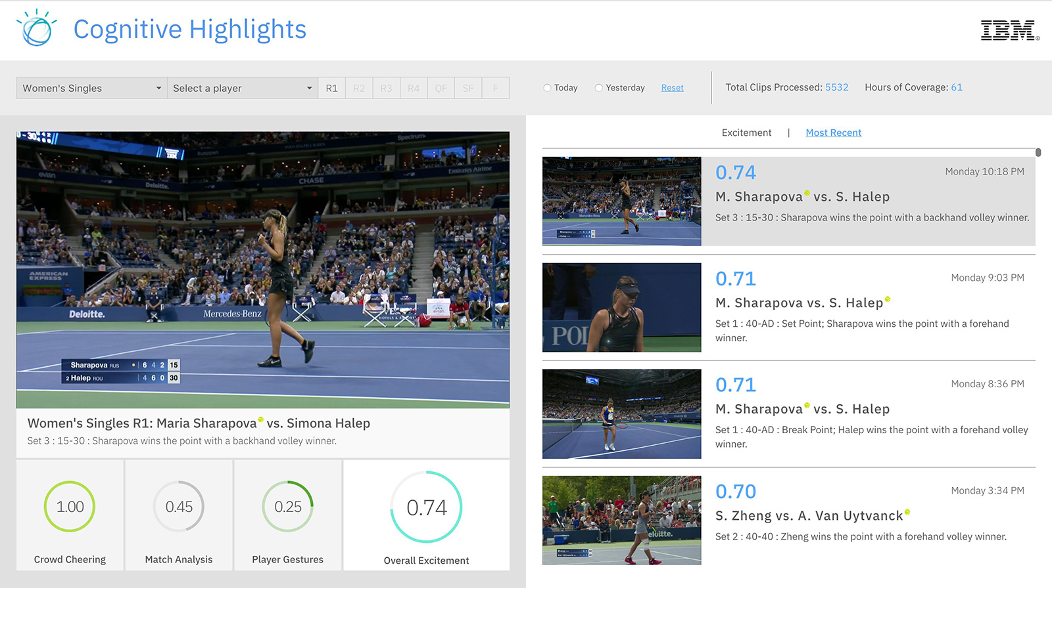























SPORTS
Mime type | Volume | Velocity | Variety | Veracity | Value | Applications | Use cases
Audio |  |  |  |  |  |  | Radio, podcasts
Video |  |  |  |  |  |  | Game film, highlights, live streams, replay
Image |  |  |  |  |  |  | Media, player identification
Text |  |  |  |  |  |  | Box scores, news, social media, sensor data
Notes:
IBM Watson

Slide 3



LOGISTICS
The hugeness of the flows handled every day with all the shipments, their weights, sizes, contact details or returns is generating an incredible amount of data that has to be managed. Big data requires a large amount of high quality information sources to work effectively.
Applications
UPS
Fedex
Amazon etc
Sources of Data
Traditional enterprise data from operational systems
Traffic & weather data from sensors, monitors and forecast systems
Vehicle diagnostics, driving patterns, and location information
Financial business forecasts
Website browsing pattern data
Social media data
Improvements
Last mile of shipping can be quickened
Reliability will be more transparent
Routes be optimized thus reducing fuel costs

Slide 4
LOGISTICS
Mime Type | Volume | Velocity | Variety | Veracity | Value
Text
Multi-part
Application

Slide 5




RESTAURANTS
Mime Type | Volume | Velocity | Variety | Veracity | Value | Applications
Text
Image
Multi-part

